Slide 1


Customer Churn in Telecom Industry
By:
Sugin Selvan. S

Slide 2


Overview Of Data
Total Values of Data
Female Churn customers
Male Churn Customers
Female Non-Churn customers
Male Non-Churn Customers
Female churn customer with their category without paperless billing
Male churn customer with their category without paperless billing
Female non-churn customer with their category without paperless billing
Male non-churn customer with their category without paperless billing
Female churn customer with their category with paperless billing
Male churn customer with their category with paperless billing
Female non-churn customer with their category with paperless billing
Male non-churn customer with their category with paperless billing

Slide 3
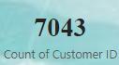
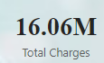

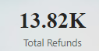
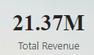

Slide 4
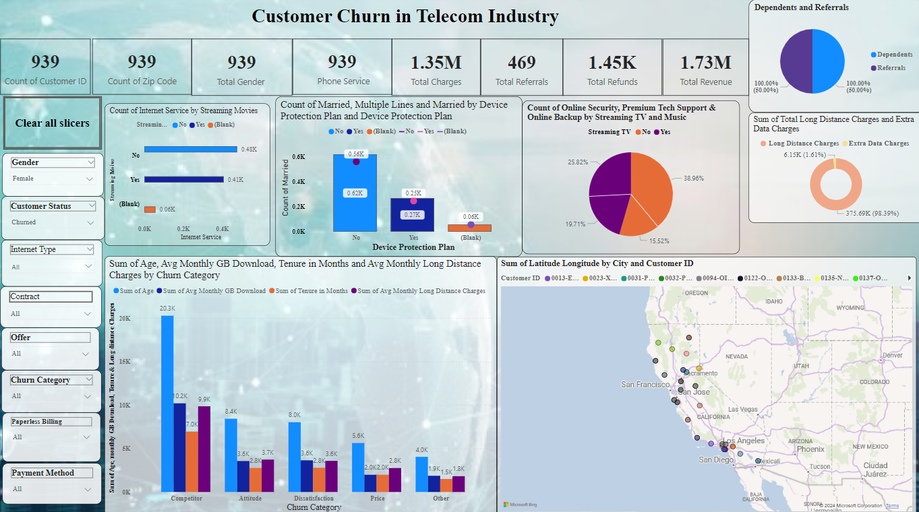
Data Filter For Female Churn customers

Slide 5
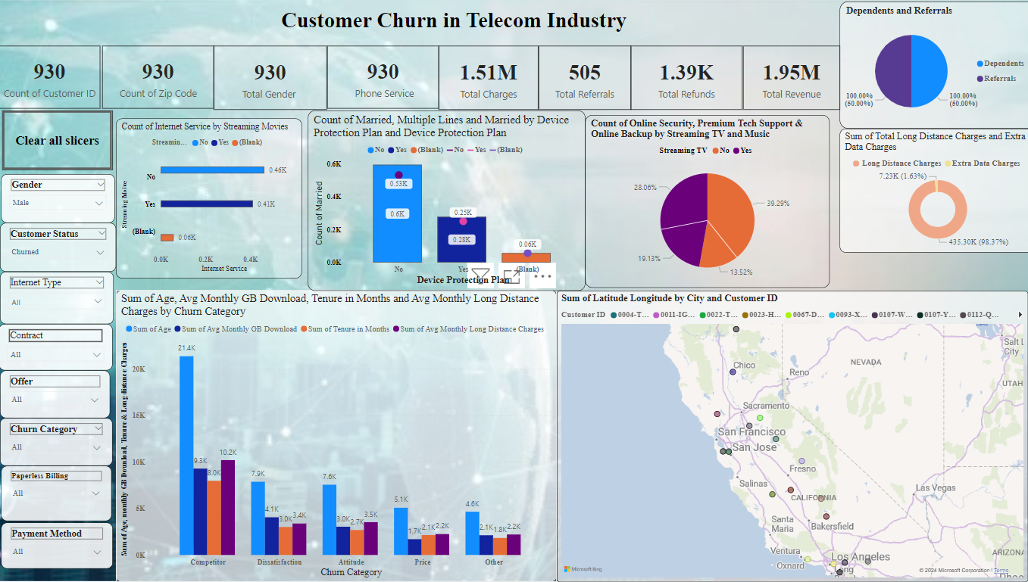
Data Filter For Male Churn Customers

Slide 6
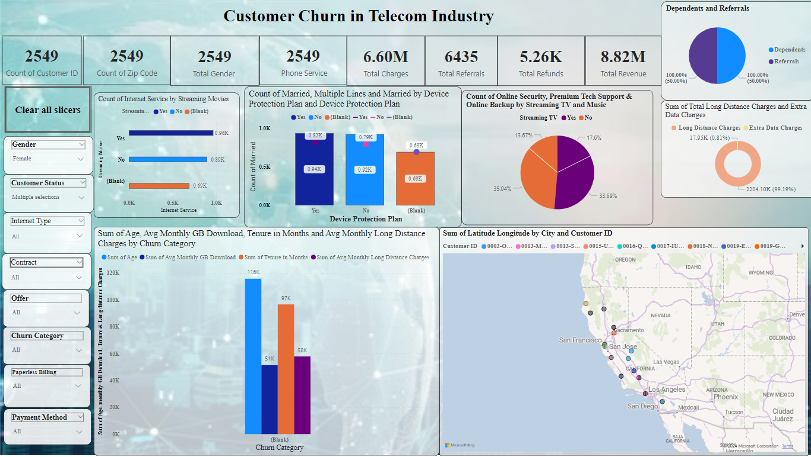
Data Filter by Female Non-Churn customers

Slide 7
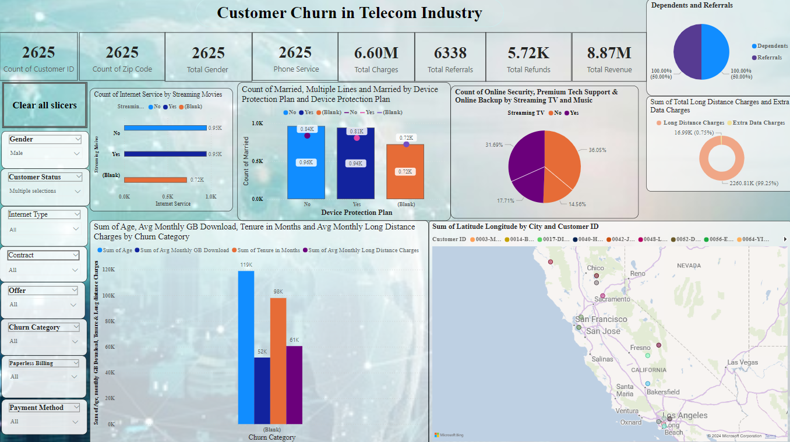
Data Filter For Male Non-Churn Customers

Slide 8
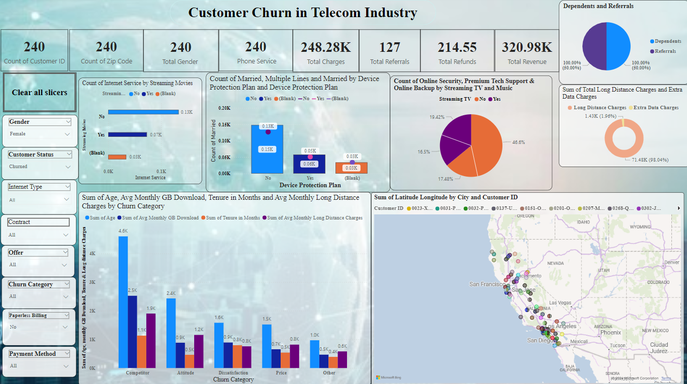
Data Filter For Female churn customer with their category without paperless billing

Slide 9
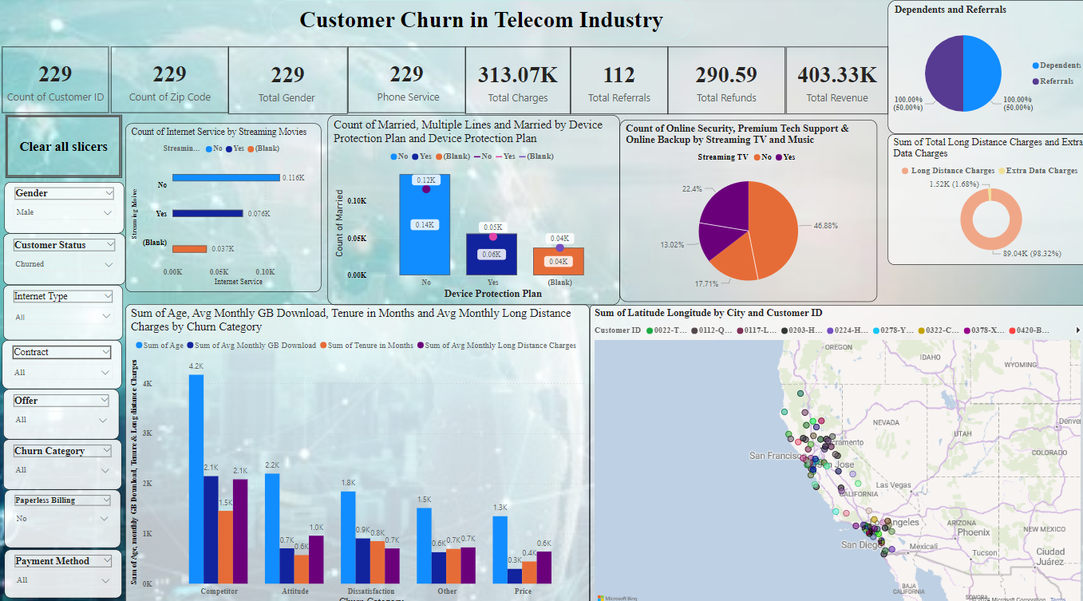
Data Filter For Male churn customer with their category without paperless billing

Slide 10
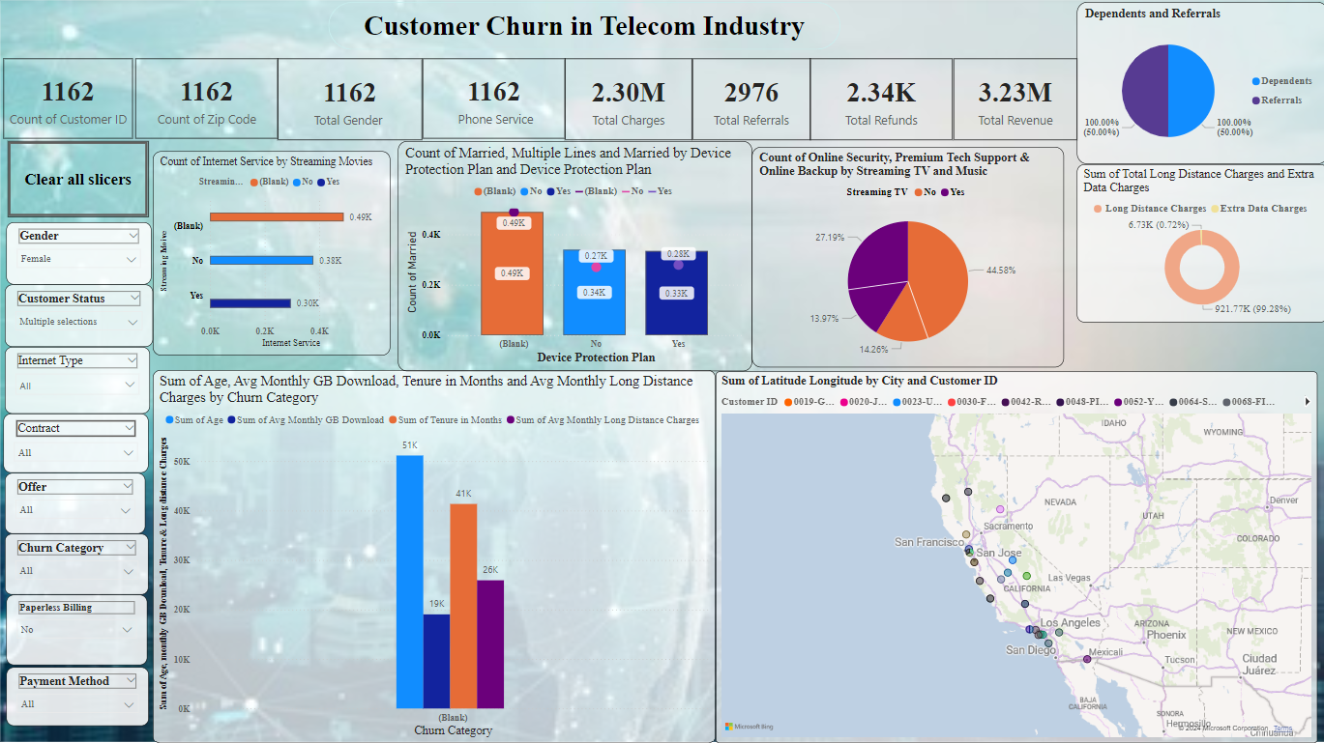
Data Filter For Female non-churn customer with their category without paperless billing

Slide 11
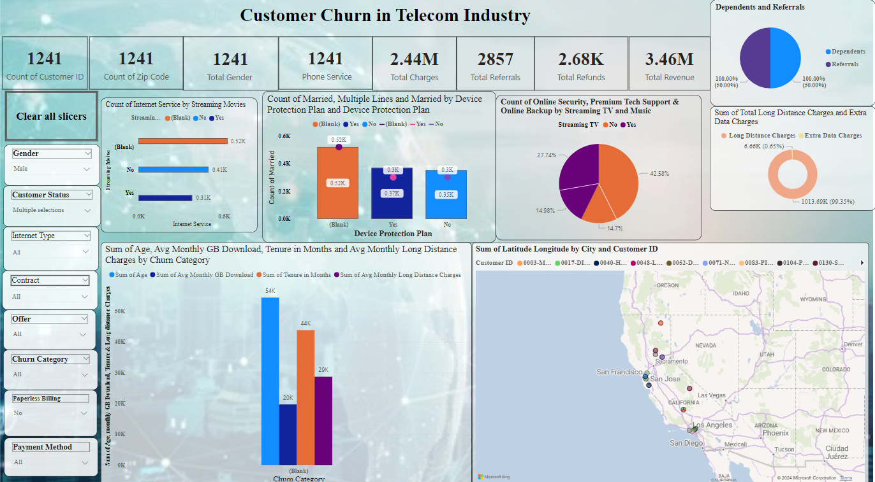
Data Filter For Male non-churn customer with their category without paperless billing

Slide 12
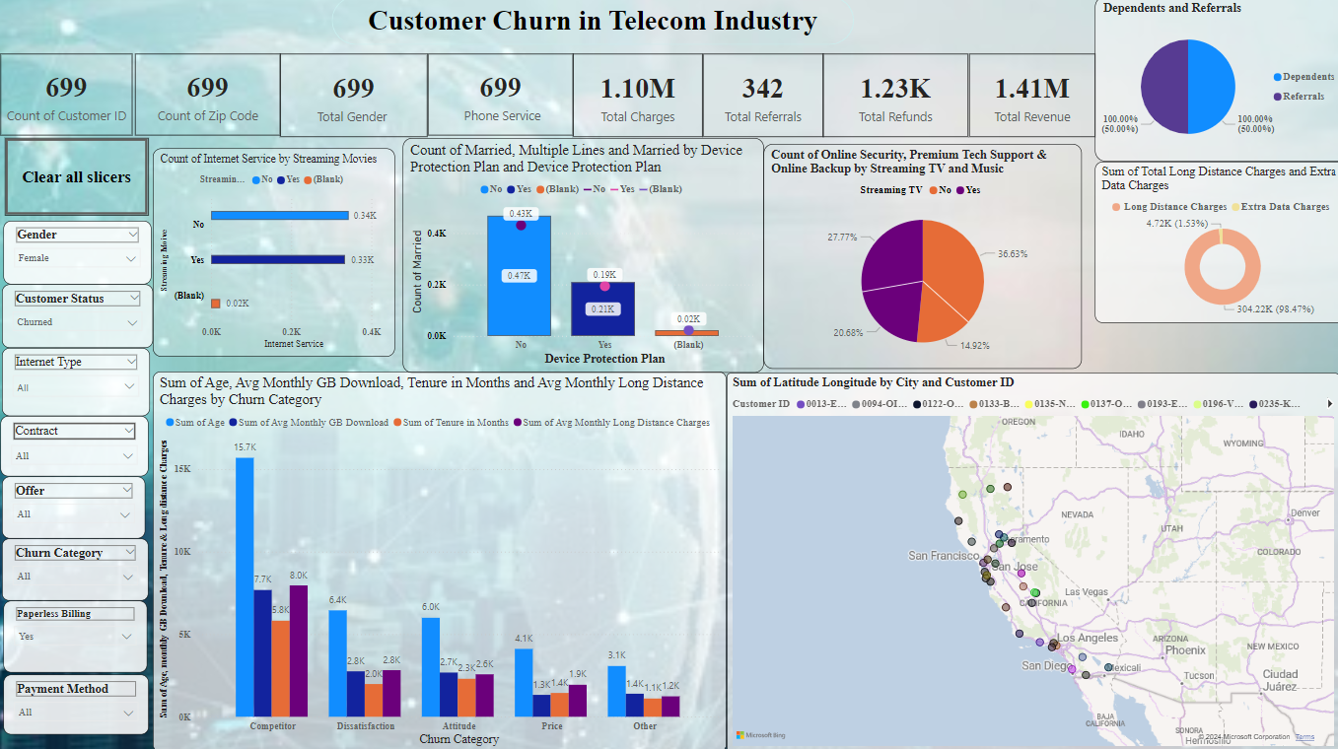
Data Filter For Female churn customer with their category with paperless billing

Slide 13
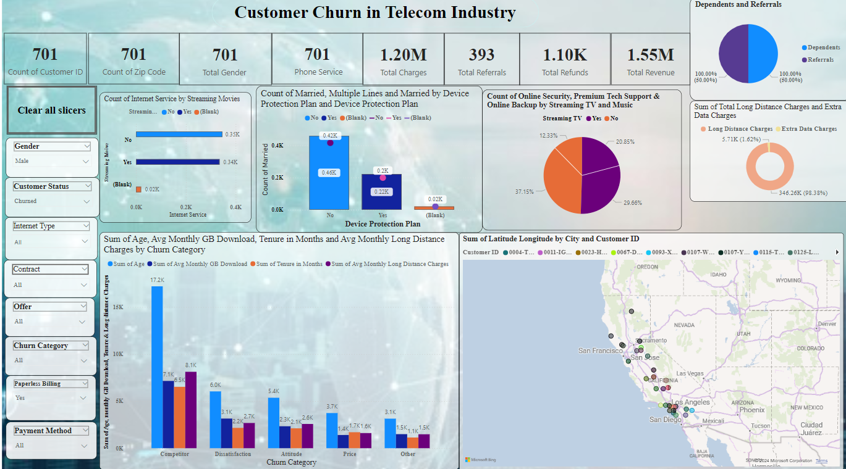
Data Filter For Male churn customer with their category with paperless billing

Slide 14

Data Filter For Female non-churn customer with their category with paperless billing

Slide 15
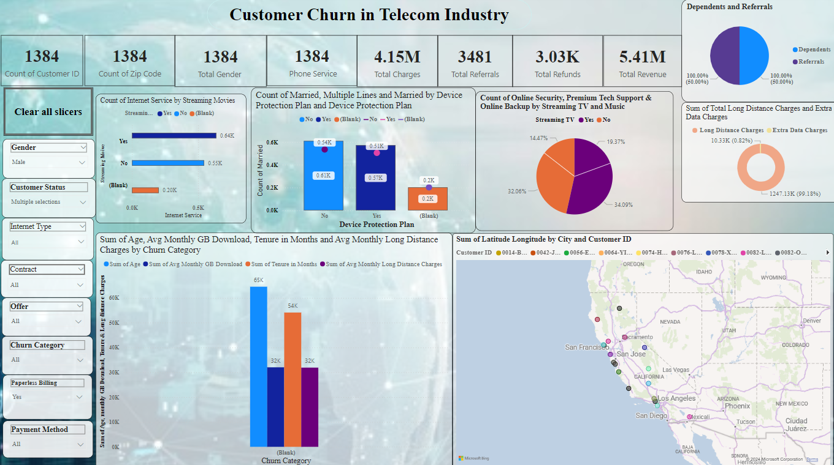
Data Filter For Male non-churn customer with their category with paperless billing

Slide 16


